Slide 1
Energy Management in Public Institutions
Learning material
Module 2

Slide 2
Fuel and energy balance. Specific consumption of fuel and energy. Main consumers of energy resources in public institutions. Rationing of costs (specific costs) of fuel and energy resources. Energy Audit

Slide 3
Literature
1. Energy Data. 2020 edition. Eurostat, 2020.
https://ec.europa.eu/eurostat/documents/3217494/11099022/KS-HB-20-001-EN-N.pdf/bf891880-1e3e-b4ba-0061-19810ebf2c64?t=1594715608000.
2. Energy balance guide. Methodology guide for the construction of energy balances & Operational guide for the energy balance builder tool. Eurostat, 2019.
https://ec.europa.eu/eurostat/documents/38154/4956218/ENERGY-BALANCE-GUIDE-DRAFT-31JANUARY2019.pdf/cf121393-919f-4b84-9059-cdf0f69ec045
3. Analysis of Household Electricity Consumption Patterns and Economy of Water Heating Shifting and Saving Bulbs.
https://www.researchgate.net/publication/258448629_Analysis_of_Household_Electricity_Consumption_Patterns_and_Economy_of_Water_Heating_Shifting_and_Saving_Bulbs
4. Energy Consumption Monitoring Analysis for Residential, Educational and Public Buildings
https://www.researchgate.net/publication/236247248_Energy_Consumption_Monitoring_Analysis_for_Residential_Educational_and_Public_Buildings
5. Why and How Scaling down TPO's ML into a Residential building
https://www.researchgate.net/publication/326693102_Why_and_How_Scaling_down_TPO%27s_ML_into_a_Residential_building

Slide 4
ENERGY BASICS - What is an Energy Balance The energy balance is the most complete statistical accounting of energy products and their flow in the economy. The energy balance allows users to see the total amount of energy extracted from the environment, traded, transformed and used by end-users. It also allows seeing the relative contribution of each energy carrier (fuel, product). The energy balance allows studying the overall domestic energy market and monitoring impacts of energy policies. The energy balance offers a complete view on the energy situation of a country in a compact format, such as on energy consumption of the whole economy and of individual sectors. The energy balance presents all statistically significant energy products (fuels) of a country and their production, transformation and consumption by different types of economic actors (industry, transport, etc.). Therefore, an energy balance is the natural starting point to study the energy sector.

Slide 5
Energy Balance Methodology In a simplified way, we can say that an energy balance is a matrix, where columns are energy products (fuels) and rows are energy flows (production – transformation – consumption). Put differently, the energy balance is an accounting framework for the compiling, reconciliating and understanding of data on all energy products entering, exiting and used within an institution. The energy balance is constructed for each calendar year. When constructing energy balances, one has to bear in mind the first law of thermodynamics. The law of conservation of energy states that total energy in an isolated system is constant; energy can be transformed from one form to another but can be neither created nor destroyed. The first law is often formulated by stating that the change in the internal energy of a closed system is equal to the amount of heat supplied to the system, minus the amount of work done by the system on its surroundings. Consequently, energy gains are not possible. If energy gains are present in data, they are results of either statistical discrepancy (data of low accuracy) or the data collection system is not fully considering all input products in the scope of energy statistics.

Slide 6
Energy types are expressed in different units
An energy manager must be familiar with energy terminology and units of measure. Different energy types are measured in different units. Knowing how to convert from one measurement system to another is essential for making valid comparisons.
There are measures for physical quantities and measures for the energy or heat content.
Physical quantities: tons (crude oil, coal); barrels (crude oil); cubic metres (gas), and litres (petrol, diesel oil).
Comparing sources of energy, with different units of measurement of physical quantities, is an extremely complex, if not impossible, task.
The official measurement unit for energy is the Joule (J).
Among the most common units measuring energy mention should be made of the kilowatt/hour (kWh), used especially for electric energy. In order to measure the production of large electricity plants or the national consumption, the Terawatt/hour (TWh) is used, which corresponds to a billion kW/h.
The most common units measuring heat include the BTU (British Thermal Unit) and the kilogram calorie (kg-cal) and especially the Tonne of Oil Equivalent.
The Tonne of oil equivalent is the most common at international level because it is connected to one of the most important and widely used fuels: oil. By measuring the different energy sources in terms of Tonne of oil equivalent, a comparison becomes possible and they can be aggregated.
Source: Barney L. Capehart, Wayne C. Turner, William J. Kennedy, 2012, page 10
http://www.eniscuola.net/en/argomento/energy-knowledge/energy-sources/energy-measurement/

Slide 7
The choice of units in the energy balance The data for the different products need to be expressed in a common energy unit. The unit chosen can be any energy unit: terajoule (TJ), gigawatt hour (GWh), thousands of tons of oil equivalent (ktoe), million tons of oil equivalent (Mtoe), etc. The unit adopted by Eurostat is the joule. The joule is a derived unit of energy in the International System of Units. It is the energy dissipated as heat when an electric current of one ampere passes through a resistance of one ohm for one second. This definition forms one of the bases of conversion between energy units: 1 GWh = 3.6 TJ.

Slide 8
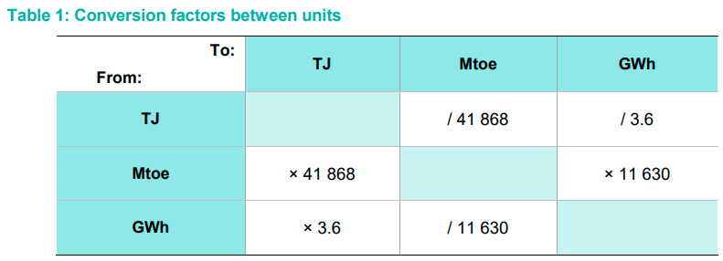
The choice of units in the energy balance

Slide 9
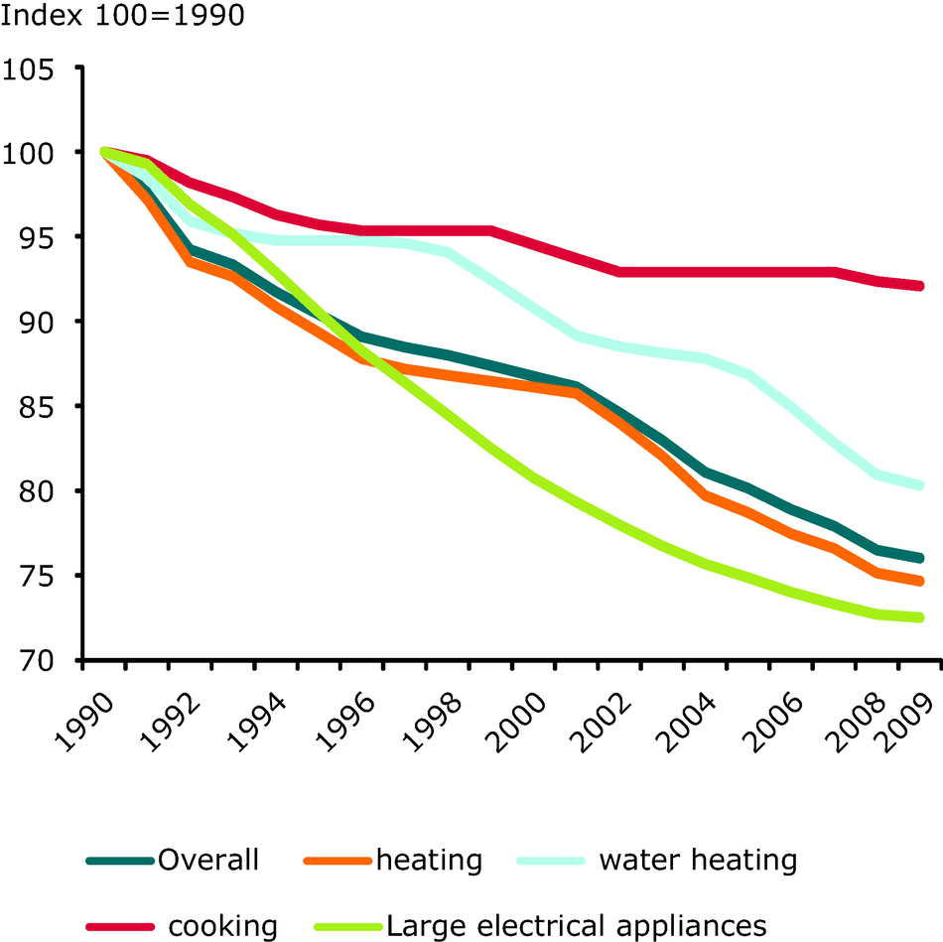
General requirements. Information and data sources for a fuel and energy balance and its analysis Purpose and objectives for the fuel and energy balance. Data sources for a fuel and energy balance: 1) Counters. 2) Energy certificate. 3) Technical documentation. Data collection – more statistic (per day, per month, per year)

Slide 10
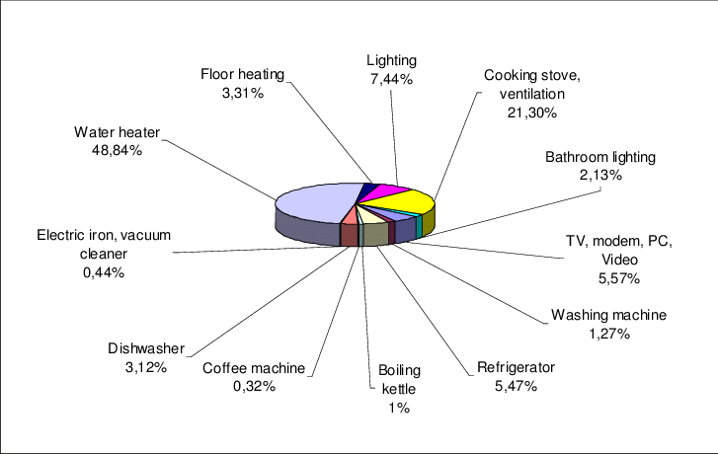
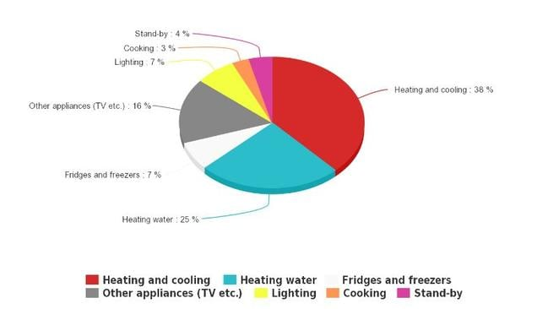
Fuel and energy balance analysis. Power consumption by different consumers

Slide 11
Fuel and energy balance analysis
Data collection: statistic of power consumption in public institutions
Hour/day statistic of energy consumption be different power consumers (household equipment, other devices, lighting)
Such statistic can be received from a specially installed energy monitoring systems inside buildings)

Slide 12
Determination of energy flows in buildings
Determination of energy flows is important for understanding the functioning of processes within the organization and for identification of possible measures. An example of energy flows is shown on Figure.
Through the understanding of energy flows in the building, a priority order can be set for the different energy efficiency measures.
Source: INTERREG CENTRAL EUROPE 2014-2020 TOGETHER TOwards a Goal of Efficiency THrough Energy Reduction. Step-by-step procedures’ handbook for EnMS in public buildings D.T2.1.5, page 24

Slide 13
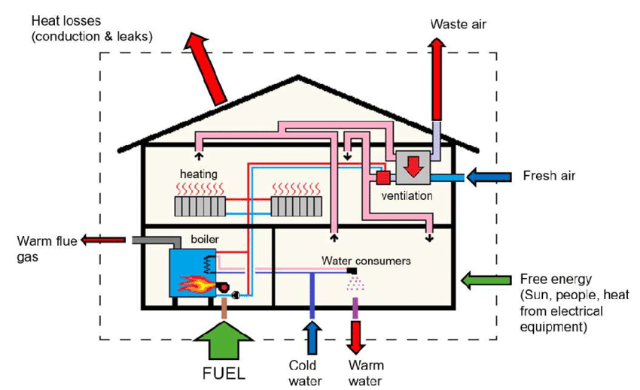
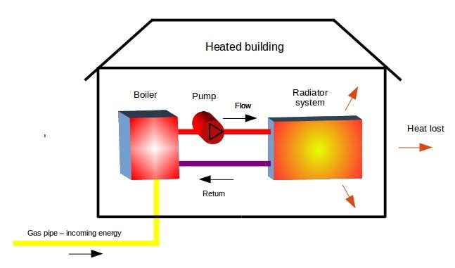
Energy flows in buildings. Main consumers of energy resources in public institution

Slide 14
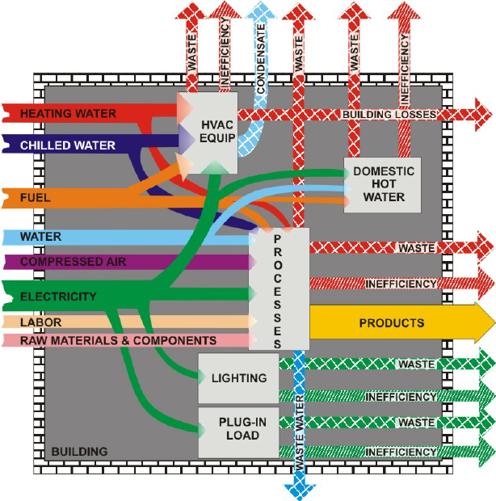
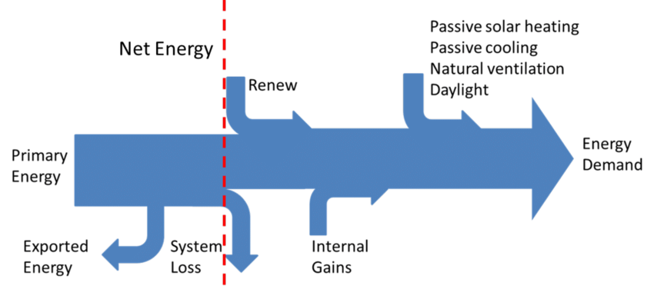
Energy flows in buildings. Main consumers of energy resources in public institutions

Slide 15
The Energy Audit Process: An Overview
Public institutions are very special buildings from the energy consumption aspect, because in most cases they are large facilities with no or low level of EnMS implemented, and what is even more important, that most of the users are just visitors, who are usually not behaving energy efficiently.
Therefore, public institutions is a huge building with a lack of control on energy efficiency.
The first step to be more energy efficient is to perform an energy audit, where results on energy efficiency baseline are obtained and the appropriate energy efficiency measures can be implemented.
Source: INTERREG CENTRAL EUROPE 2014-2020 TOGETHER TOwards a Goal of Efficiency THrough Energy Reduction. Step-by-step procedures’ handbook for EnMS in public buildings D.T2.1.5, page 19

Slide 16
Energy auditing
The energy audit is one of the first tasks to be performed in order to accomplish higher energy efficiency and reducing energy costs for any building, company, or industry.
An energy audit consists of a detailed examination of how a facility uses energy, what the facility pays for that energy, and finally, a recommended program for changes in operating practices or energy-consuming equipment that will cost-effectively save money on energy bills.
Energy audit: A systematic procedure to obtain adequate knowledge of the existing energy consumption profile of a building or group of buildings, of an industrial operation and/or installation or of a private or public service, identify and quantify cost effective energy savings opportunities, and report the findings.
Source: INTERREG CENTRAL EUROPE 2014-2020 TOGETHER TOwards a Goal of Efficiency THrough Energy Reduction. Step-by-step procedures’ handbook for EnMS in public buildings D.T2.1.5, page 19

Slide 17
The energy audit examines the ways energy is currently used in that facility and identifies some alternatives for reducing energy costs.
The goals of the audit are:
to clearly identify the types and costs of energy use,
to understand how that energy is being used—and possibly wasted,
to identify and analyze alternatives such as improved operational techniques and/or new equipment that could substantially reduce energy costs,
to perform an economic analysis on those alternatives and determine which ones are cost-effective for the business or industry involved.
Source: Barney L. Capehart, Wayne C. Turner, William J. Kennedy, 2012, page 61

Slide 18
Types and basic components of energy audit
Depending on the type of facility, industrial processes, problems, purpose and scope of energy audits, energy audits can be classified into three groups:
Walk-through (or) preliminary energy audit: it represents the simplest form of energy audit, which presents generally the basis for a simplified or extended energy audit. The analysis is made on the basis of a one-day visit and on the basis of energy consumption data collected through a questionnaire.
Simplified energy audit: following type in complexity is the simplified version, which is enough for simple and easy to understand buildings such as offices, small industrial processes, where it is not necessary to do many measurements and inquiries, because most of consumers are already known.
Extended energy audit: it is the most common form of inspection, containing accurate economic indicators for recommended energy efficiency measures. The total consumption of energy products and electricity, according to all consumers, wherever possible. Extended energy audit constitutes a relevant basis for decision-making on investments by the management company or owners.
Source: INTERREG CENTRAL EUROPE 2014-2020 TOGETHER TOwards a Goal of Efficiency THrough Energy Reduction. Step-by-step procedures’ handbook for EnMS in public buildings D.T2.1.5, page 22

Slide 19
Energy audit for Public Institutions
Extended version of energy audit is an appropriate decision in case of public buildings for the following reasons:
Public buildings are in most cases large and complicated structures, which are though to investigate (it takes a lot of time and knowledge of the buildings).
There are usually complicated HVAC systems in order to ensure a comfortable indoor environment and to provide the requirements of different special areas (swimming pool, theatre, museum, etc.)
Mixed structure of users (regular users and visitors).
While the details of energy audits vary between different building types, the basic elements stay the same for all energy audits:
Initial contact and a preliminary meeting.
Data collection - analysis of the energy situation and energy management.
Fieldwork.
Analysis of gathered information and selection of potential energy efficiency measures.
Report.
Final meeting and presentation of energy audit report.
Source: INTERREG CENTRAL EUROPE 2014-2020 TOGETHER TOwards a Goal of Efficiency THrough Energy Reduction. Step-by-step procedures’ handbook for EnMS in public buildings D.T2.1.5, page 22

Slide 20
The types of measures
A range of measures are broadly divided into organizational and investment ones.
All measures have to be considered from feasibility and financial point of view.
Organizational measures are not normally do requiring financial input, or the required amount is insignificant compared to the possible energy reduction and savings. Therefore, these measures are feasible in the short term and allow small and medium-sized savings.
Investment measures which involve financial input have to be evaluated by the auditor with regards to the payback period and the possibility of implementation.
Source: INTERREG CENTRAL EUROPE 2014-2020 TOGETHER TOwards a Goal of Efficiency THrough Energy Reduction. Step-by-step procedures’ handbook for EnMS in public buildings D.T2.1.5, page 24

Slide 21
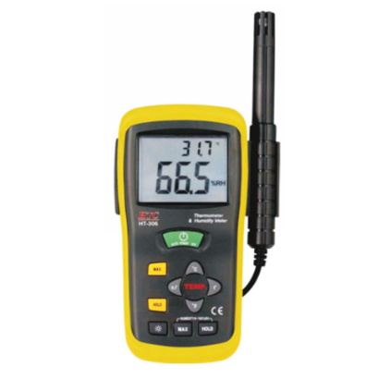
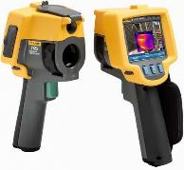
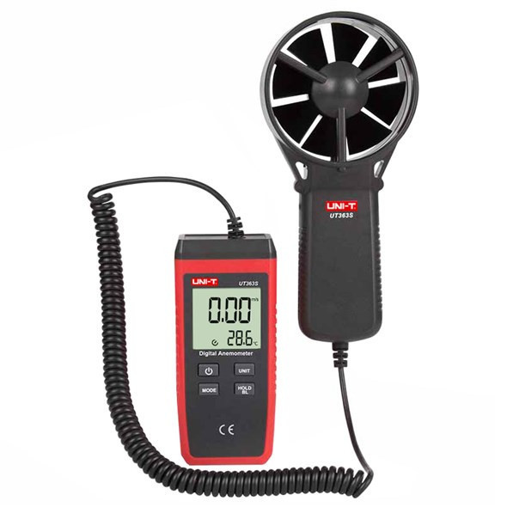
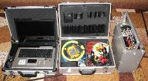
Main equipment for Energy Audit
Thermal Conductivity Meter
Humidity and TemperatureMeter
Infrared Camera
Special Complex for Audit of Electrical Facilities
Anemometer
Infrared Pyrometer

Slide 22
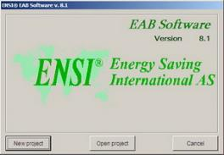
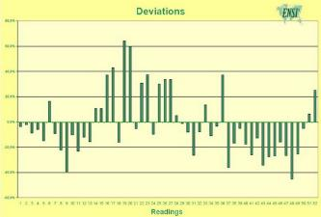
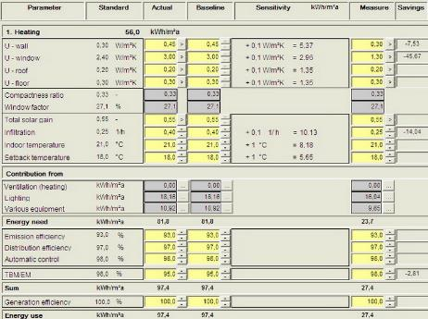
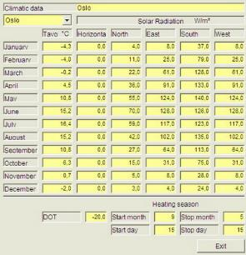
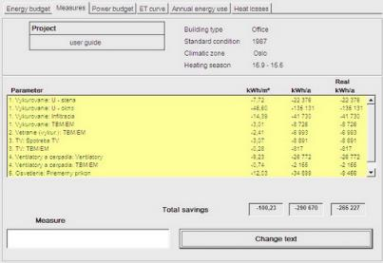
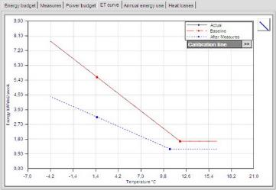
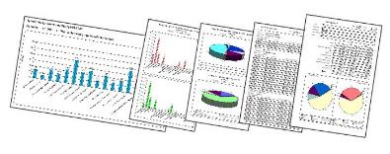
Specialized Software for Energy Audit

Slide 23
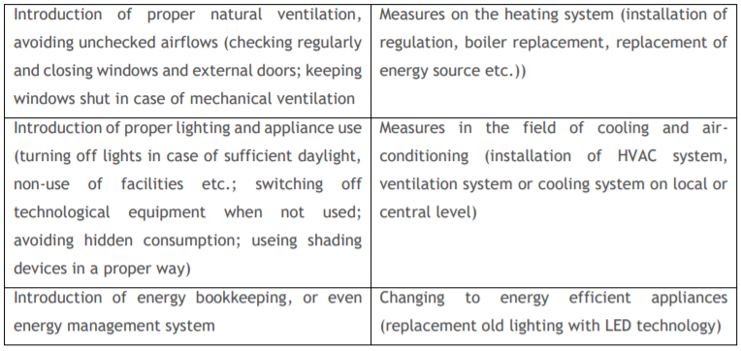
The most common organizational and investment measures
Source: INTERREG CENTRAL EUROPE 2014-2020 TOGETHER TOwards a Goal of Efficiency THrough Energy Reduction. Step-by-step procedures’ handbook for EnMS in public buildings D.T2.1.5, page 24-25

Slide 24
Energy management measures: Measuring – monitoring – target setting
They make up the first level of energy management tasks, where there is neither energy nor cost savings. However, these tasks are crucial from an efficient energy management perspective. Sustainable energy savings cannot be achieved without knowing where and with what purpose the energy is used, the amount of energy used, factors influencing it, where and at what points intervention is required, and what measures should be taken to achieve energy rationalisation. Major energy consumers, energy loss sources and the amount of lost energy are to be identified as well.
Kádárné Horváth 2014

Slide 25
Measuring energy consumption: to identify the presence of measurement conditions, namely, to map whether the organisation has enough utility meters and submeters, and to identify the levels where the accurate measurements of energy consumption are performed and to examine the frequency of these measurements.
Monitoring. Monitoring and analysing the energy consumption and energy costs are of vital importance from an energy management perspective. It is not sufficient to examine only the trends in energy usage and energy costs – the reasons lying behind these trends are also worth considering. Several factors have a considerable impact on energy consumption and energy costs. The savings resulting from energy rationalisation measures, should be distinguished from the savings that result from changes in the weather, in the organisational structure, or in purchasing strategies and in energy prices.
Identifying energy losses. Energy losses can be experienced at several levels. Apart from shipping, distribution and transformation losses, there may be technological and overheadnature losses. It is of utmost importance whether companies identify the main sources of energy losses or quantify the losses in some way. If monetary losses are quantified, management become sensitive to these losses, which helps them overcome their vulnerability.
Setting goals and norms. Taking into account the outcome of analyses, a company sets goals related to energy savings. The goals should be clear, realistic, relevant to the specific features of the area under analysis, and measurable. An additional criterion is the presence of concrete action plans including resource, cost and timescale analyses, a list of names of responsible persons with set deadlines, and evidence for goal implementation, feedbacks and regular reviews.
Kádárné Horváth 2014

Slide 26
Energy management measures: measures not requiring a considerable investment
Energy purchase is not accompanied by considerable additional costs. Considerable energy costs can be saved by adopting appropriate energy purchasing strategies.
The role of energy purchasing in saving energy costs has increased after the liberalisation process of energy markets. Different types of contracts have been concluded in the free market, which requires better preparedness and knowledge from energy managers. Comparing offers submitted by energy traders competing in the energy market is also a complicated process. Apart from the negotiated prices and the network fees, there are several other contractual terms and conditions that should be taken into account. It is by no means certain that the contract offering the lowest price is really that cheap.
Energy saving measures: in this case energy can be saved by placing consumers in a worse situation (providing heating at a lower temperature).
Energy efficiency measures: In this case, energy consumption is reduced; however, the original degree of comfort remains. This idea involves such simple actions as turning off machinery and interrupting power, eliminating the standby mode, encouraging employees’ conserving behaviour, setting appropriate lightning levels, or identifying and utilising natural lighting options.
Kádárné Horváth 2014

Slide 27
Energy management measures: Investments in improving energy efficiency
The main areas of investments:
Lighting
Heating, Ventilating, and Air Conditioning
Understanding and Managing Boilers
Steam Distribution Systems
Control Systems and Computers
Energy Systems Maintenance
Insulation
Process Energy Management
Renewable Energy Sources and Water Management
The tasks on this level have financial implications since decision making involves financial considerations. In order to implement investments, a financial basis is to be established.
Kádárné Horváth 2014

Slide 28
Thank you for your kind attention!

