Slide 1
Energy Management in Public Institutions
Learning material
Module 3

Slide 2
Features of energy management application for efficient energy supply of public institutions. Systems of energy management.

Slide 3
Literature
Rikin Tailor, Management system for smart house and smart street , Diploma thesis, 2020, TUKE
PAS – The Energy Management Handbook – Second Edition (2010) ISBN 0-9778969-2-7
Building Automation for Energy Efficiency Mojtaba Navvab, ... Stefano Panzieri, in Handbook of Energy Efficiency in Buildings, 2019
Energy Management Systems for Hybrid AC/DC Microgrids Moein Manbachi, in Operation of Distributed Energy Resources in Smart Distribution Networks, 2018
https://www.energy.gov/eere/wipo/energy-management-systems-maximizing-energy-savings-text-version
https://www.greenbyte.com/product/centralize?gclid=CjwKCAjwnef6BRAgEiwAgv8mQSzA_jPSVrzCsk8rMlA178_S5IY2_FGElm2ZUUyz554iVaItzDpu8xoCNOgQAvD_BwE
Communication Based Control for DC Microgrids – IEEE Journals & Magazine". doi:10.1109/TSG.2018.2791361.
Energy management algorithm for resilient controlled delivery grids – IEEE Conference Publication". doi:10.1109/IAS.2017.8101777

Slide 4
CONTENTS
Energy management systems
Building management systems
General requirements
Features of energy management application for efficient energy supply

Slide 5
Energy management systems
An Energy Management System (EMS) is a system of computer-aided tools used by operators of electric utility grids to monitor, control, and optimize the performance of the generation, consumption or transmission system.
Also, it can be used in small scale systems like microgrids.
The computer technology is also referred to as SCADA/EMS or EMS/SCADA.
In these respects, the terminology EMS then excludes the monitoring and control functions, but more specifically refers to the collective suite of power network applications and to the generation control and scheduling applications.

Slide 6
Energy management systems
Building energy management system (BEMS) is a computer based control system installed in buildings.
BEMS integrates the monitor and control of mechanical and electrical systems within a building into an overall control and optimisation strategy related to energy, occupant comfort, etc.
BEMS also gathers, analyses and controls building performance data such as temperature, humidity, levels of carbon dioxide, room illumination, etc., of various spaces in a building. BEMS’s components are generally laid out in a four-level system:
Sensors, switches, etc., at the field (equipment) level
Outstations and discrete controllers at the control level
Central station with a computer based control system at the operation level
Central station communication via gateways at the management level.

Slide 7
Energy management systems
A list of systems that can be monitored or controlled by a BEMS are shown below:
Illumination (lighting) control
Electric power control
Heating, ventilation, and air conditioning
Security and observation
Access control
Fire alarm system
Lifts, elevators etc.
Plumbing
Closed-circuit television (CCTV)
Other engineering systems
Control Panel
PA system
Alarm Monitor
Security Automation

Slide 8
Energy management systems
Many benefits exist when a BMS is installed in a building, some of them are:
Possibility of individual room control
Increased staff productivity
Effective monitoring and targeting of energy consumption
Improved plant reliability and life
Effective response to HVAC-related complaints
Save time and money during the maintenance
Occupancy sensors allow automatic setback override during unoccupied periods as well as adaptive occupancy scheduling.
Lighting controls reduce unnecessary artificial lighting via motion sensors and schedules as well as by controlling daylight harvesting louvers
Controllers save water and energy by controlling rainwater harvesting and landscape irrigation

Slide 9
Energy management systems
Many benefits exist for building managers:
Higher rental value
Flexibility on change of building use
Individual tenant billing for services facilities time saving
Remote monitoring of the plants (such as AHU's, fire pumps, plumbing pumps, electrical supply, STP, WTP, greywater treatment plant etc.)
Ease of maintenance
Benefits for maintenance companies:
Ease of information availability
Computerized maintenance scheduling
Effective use of maintenance staff
Early detection of problems or service work easy
More satisfied occupants

Slide 10
Energy management systems
BEMS, in its most recent form, benefits from advanced development of intelligent/smart technologies and communications, such as wireless technologies.
These technologies empower BEMS to extend its scope, such as optimising energy efficiency through interoperable services and dynamic control of multiple equipments and technological systems.
Other advanced approaches include communication among sensors, context-aware, user-adaptive, prioritisation of information, etc. (European Commission, 2009).
For example, lighting sensors from a room’s daylight system can send signals of overcast sky to BEMS.
The system then analyses data from motion sensors installed in the room to detect whether the room is in use, in order to decide to whether to automatically switch on supplemental artificial lighting.
Such data are also used to determine whether air-conditioning in that particular room should be turned off or remain to be on.

Slide 11
Energy management systems
Building management systems are most commonly implemented in large projects with extensive mechanical, HVAC, and electrical systems.
Systems linked to a Building management systems typically represent 40% of a building's energy usage; if lighting is included, this number approaches to 70%.
Building management systems systems are a critical component to managing energy demand.
Improperly configured BMS systems are believed to account for 20% of building energy usage.

Slide 12
Energy management systems
ISO 50001:2011 specifies requirements for establishing, implementing, maintaining and improving an energy management system, whose purpose is to enable an organization to follow a systematic approach in achieving continual improvement of energy performance, including energy efficiency, energy use and consumption.
ISO 50001:2011 specifies requirements applicable to energy use and consumption, including measurement, documentation and reporting, design and procurement practices for equipment, systems, processes and personnel that contribute to energy performance.
ISO 50001:2011 applies to all variables affecting energy performance that can be monitored and influenced by the organization. ISO 50001:2011 does not prescribe specific performance criteria with respect to energy.
ISO 50001:2011 has been designed to be used independently, but it can be aligned or integrated with other management systems.
ISO 50001:2011 is applicable to any organization wishing to ensure that it conforms to its stated energy policy and wishing to demonstrate this to others, such conformity being confirmed either by means of self-evaluation and self-declaration of conformity, or by certification of the energy management system by an external organization.
ISO 50001:2011 also provides, in Annex A, informative guidance on its use.

Slide 13
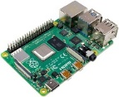
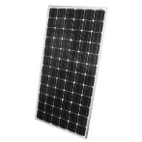
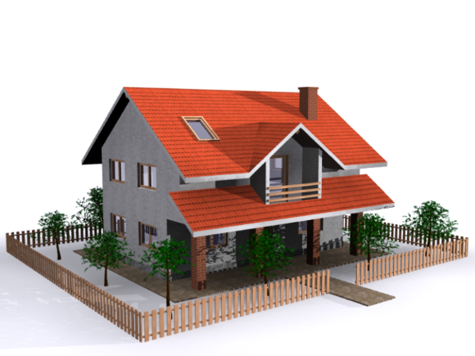
Features of energy management system application
Automated, Manual control
Electricity operator control for Maintenance or holiday features
Smart plug control
Daily, Monthly and yearly metering of Electricity and consumption and generation from renewables.
Battery status indicator
Auto control for utilizing electricity from grid and home storage
Light dimmer control automatic according to sun rays
Time schedule control
Group switch control
World Wide control
Control of Electric Energy, Heating Energy, Cooling Energy
Two way communication flow ( Sensing temperature and according to that send turning ON/OFF command)
Obey the rules of IOE (Internet of Electricity)
Smart lock control
Block chain security control or transferring data
Two way communication between electricity operator and home application
Direct communication with smart meter
Alarm control in case of emergency (Police, Ambulance and Fire Van)

Slide 14
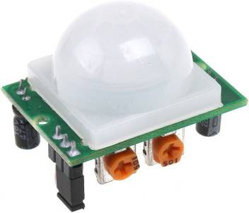
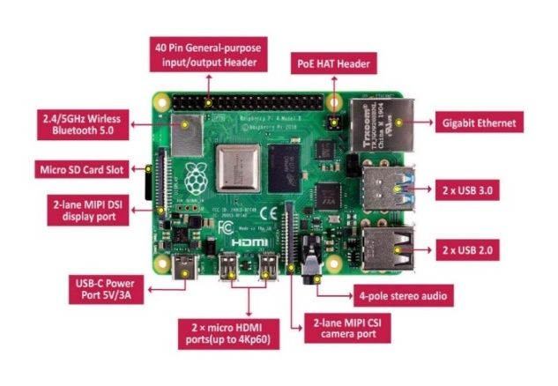
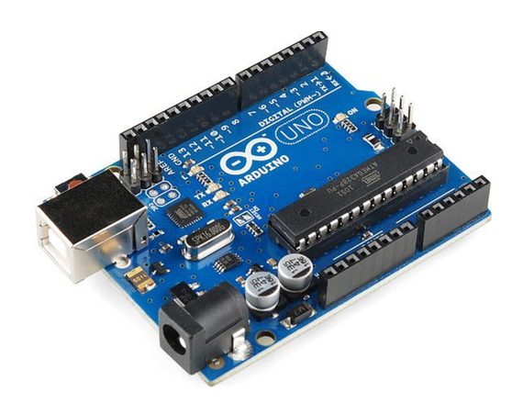
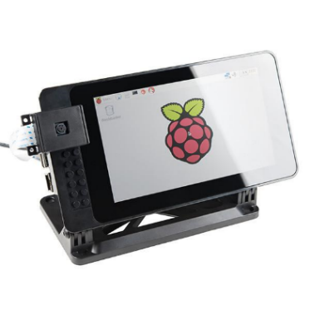
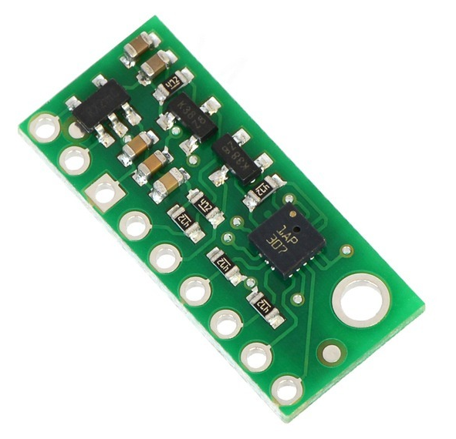
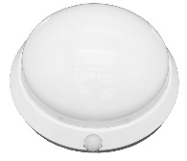
Features of energy management system application
Touch Screen
Monitoring Display
Raspberry Pi 4B
Arduino AT Mega 328
Sensors
Home Automation Kit with Application
Raspberry pi 4 version with 4 GB RAM and Arduino AT Mega 328
32 GB MicroSD card
15 Watt power full charger
7” inch Display
Home Area Network
Various Sensors
Power Electronic circuit
Development of Application:
Web Application, Mobile Application,
Java/Python/C++ environment for development
Communication using Internet (Wifi)

Slide 15
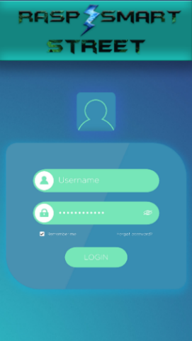
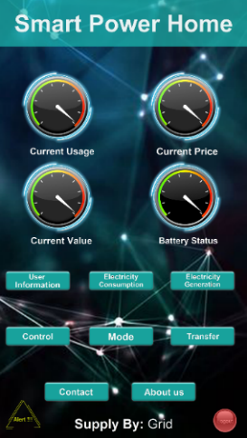
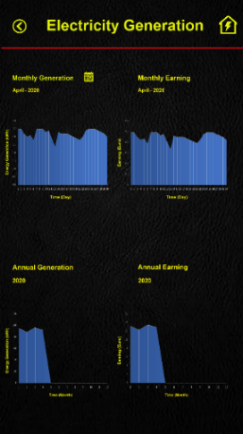
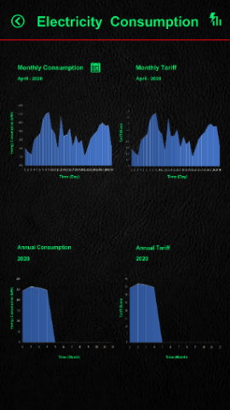
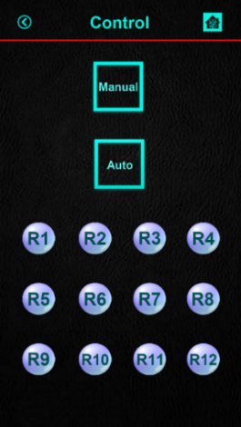
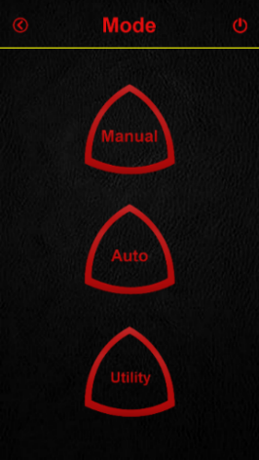
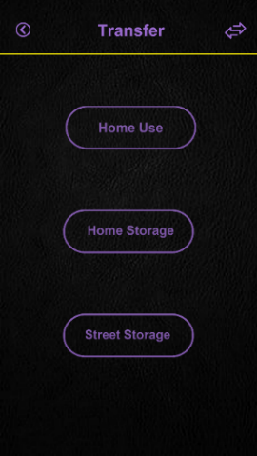
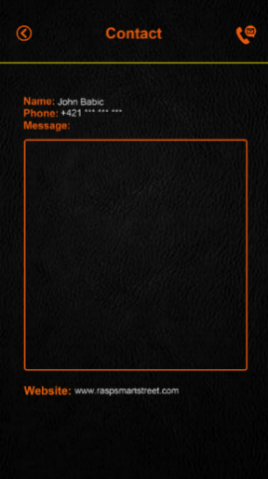
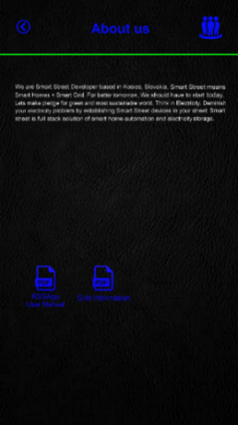
Features of energy management system application
Login Page
Home Page
User Information
Electricity Generation
Electricity consumption
Control
Mode
Transfer
Alert!!!
Contact
About us

Slide 16
Thank you for your kind attention!

